Slide 1
How a Diverse Energy Portfolio Can Achieve Clean Energy Goals
Ellen Ginsberg
Sr Vice President, General Counsel and Secretary
January 12, 2021

Slide 2
Nuclear generates nearly 20% of U.S. electricity
Biomass & Petroleum – 1.9%
Solar – 1.8%
Geothermal – 0.4%
Hydro
6.8%
Nuclear
19.7%
Wind
7.3%
Coal
23.5%
Natural Gas
38.4%
KEY
Nuclear power plant site
Source: U.S. Energy Information Administration
Updated: February 2020

Slide 3
Growth from efficiency improvements and uprates are equivalent to 32 new 1,000 megawatt power plants
Electricity
Generated
(Million MWh)
Equivalent to 32 new power plants
Source: Emissions avoided are calculated using regional and national fossil fuel emissions rates from the U.S. Environmental Protection Agency and plant generation data from the U.S. Energy Information Administration.
Updated: March 2020

Slide 4
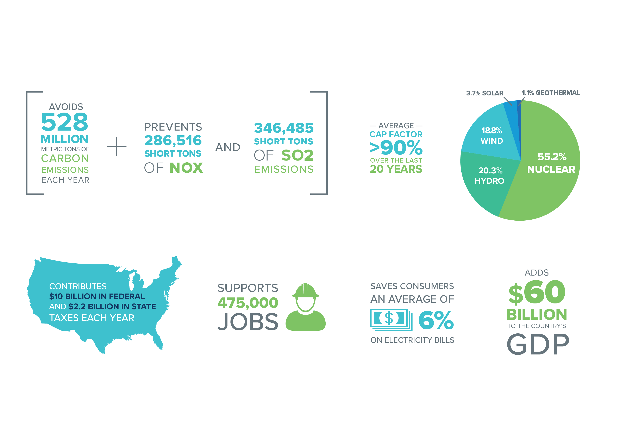
Nuclear Contributions

Slide 5
Nuclear supplied more than half of U.S. carbon-free electricity in 2019
Solar – 4.9%
Geothermal – 1.1%
Carbon-free resources generated about 37% of U.S. electricity in 2019
Carbon-free generation in U.S. increased by net 18.7 million MWh in 2019
Hydro
18.9%
Nuclear
54.8%
Wind
20.3%
Source: U.S. Energy Information Administration
Updated: February 2020

Slide 6
Emissions avoided by the nuclear industry in 2019 are equivalent to emissions from nearly 110 million cars
CO₂ Emissions (Million Metric Tons)
Source: Emissions avoided are calculated using regional and national fossil fuel emissions rates from the U.S. Environmental Protection Agency and plant generation data from the U.S. Energy Information Administration.
Updated: July 2020

Slide 7
Utility carbon emission projections based on pledges
Source: ABB Velocity Suite, U.S. Environmental Protection Agency, utility news releases.

Slide 8
Recognizing the Carbon-Free Attribute
Utility plans
Duke Energy
SLR planned for all 11 reactors
SMRs, Advanced Reactors an option in IRP
Dominion Energy
SLR applications under review for all 4 reactors
SMRs, Advanced Reactors an option in IRP
Multiple generating companies reportedly teaming with developers for Advanced Reactor Demonstration Program awards
UTILITY DECARB PLANS INCLUDE SLR, ROLE FOR NEW NUCLEAR

Slide 9
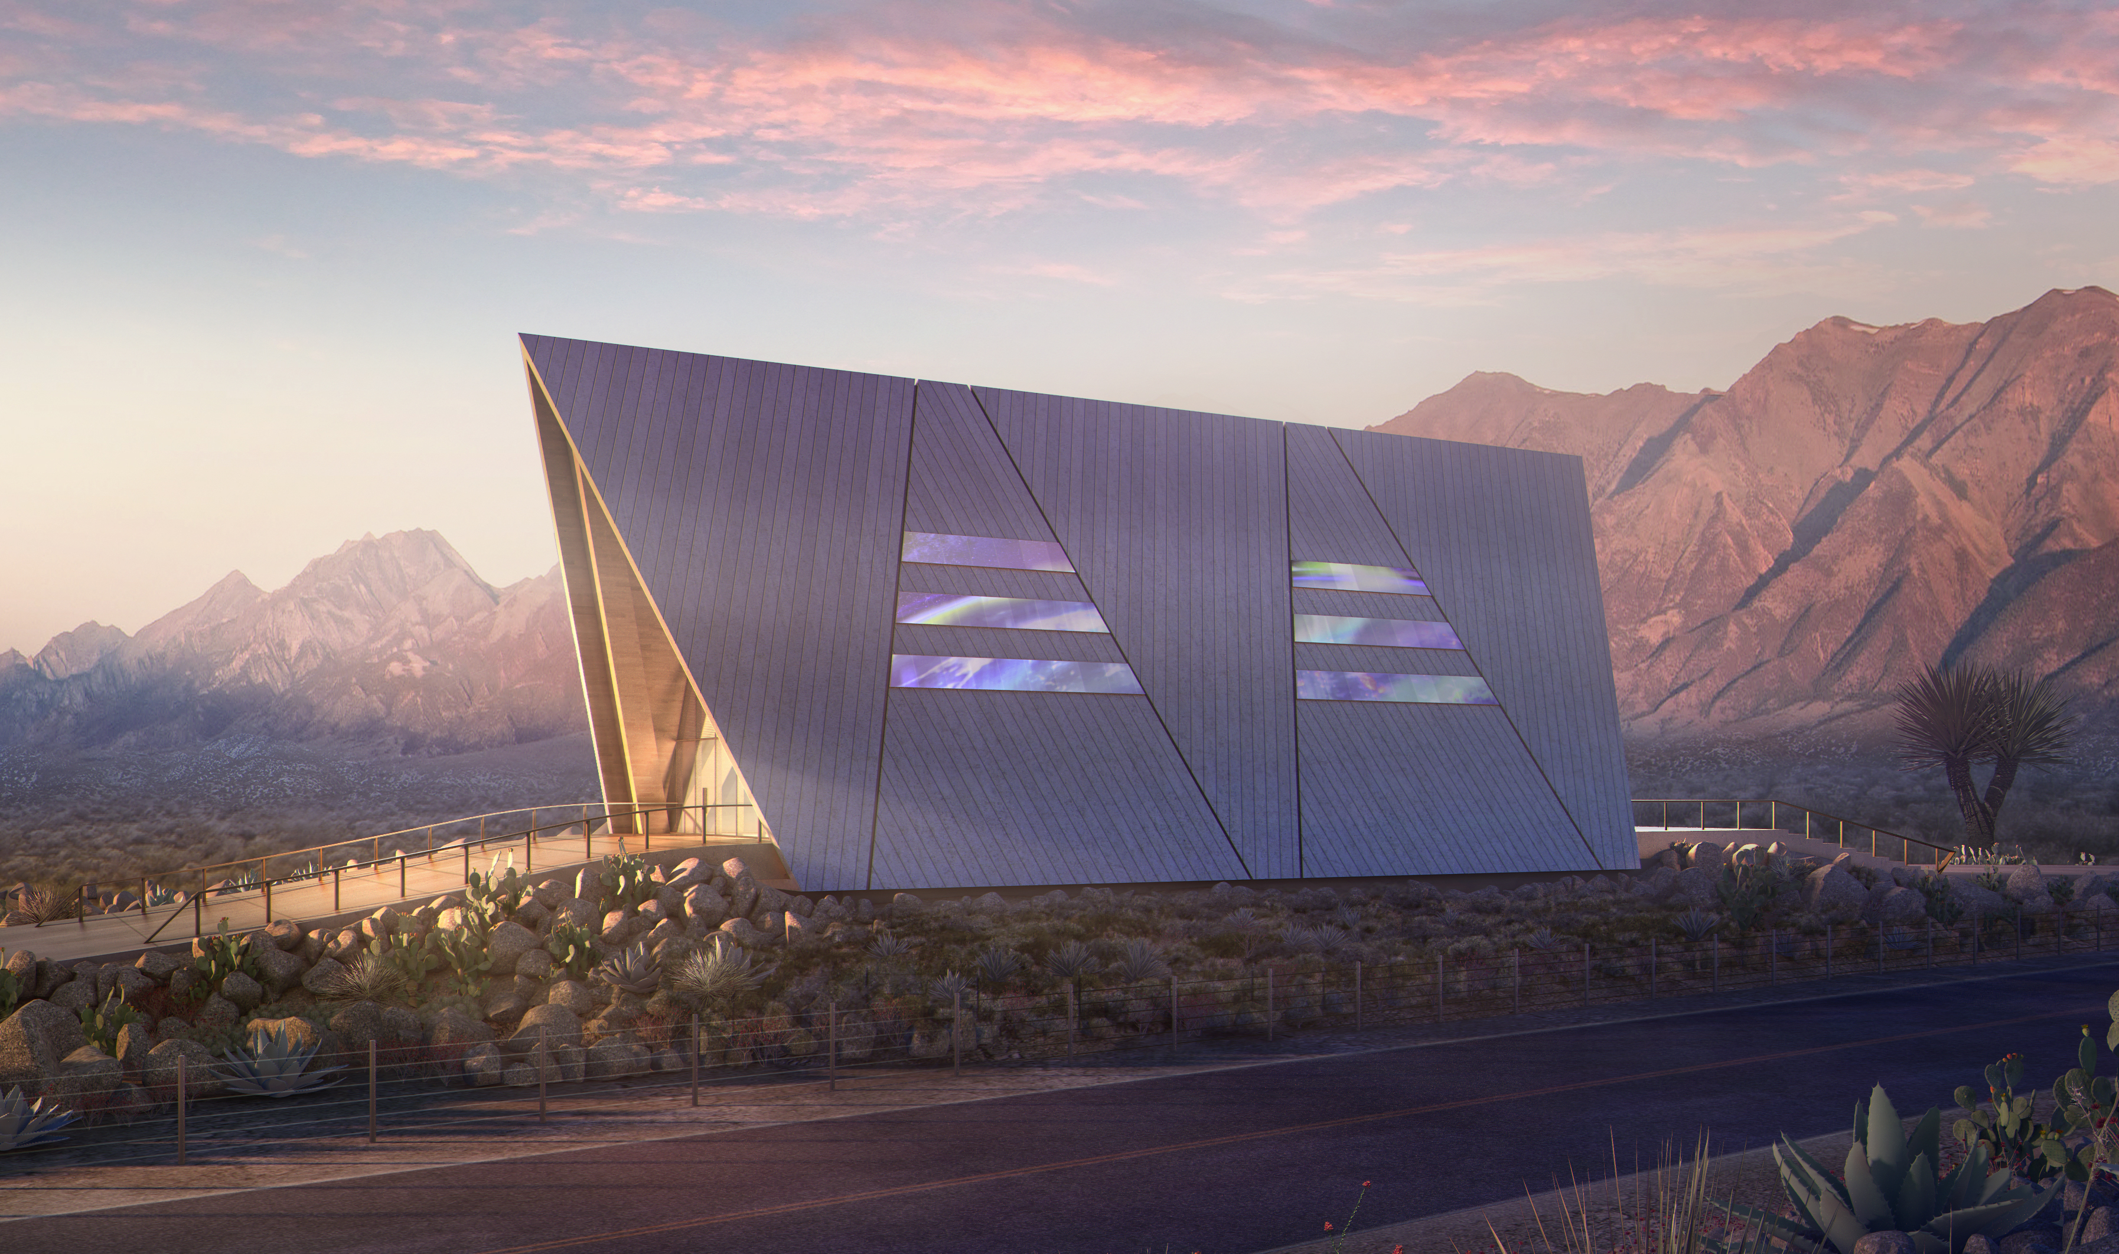
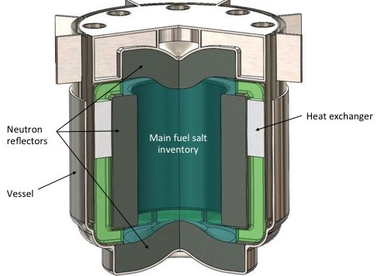

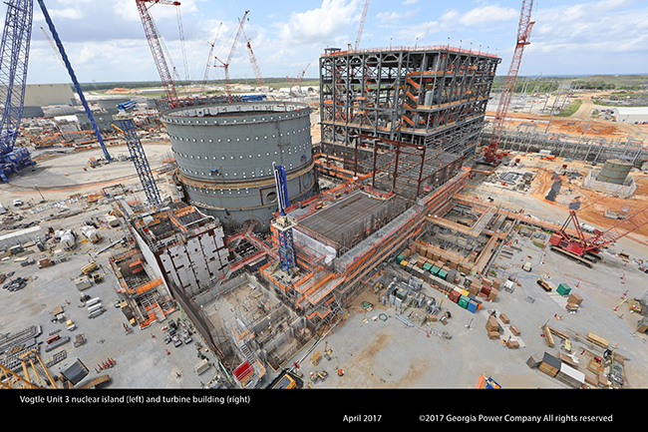
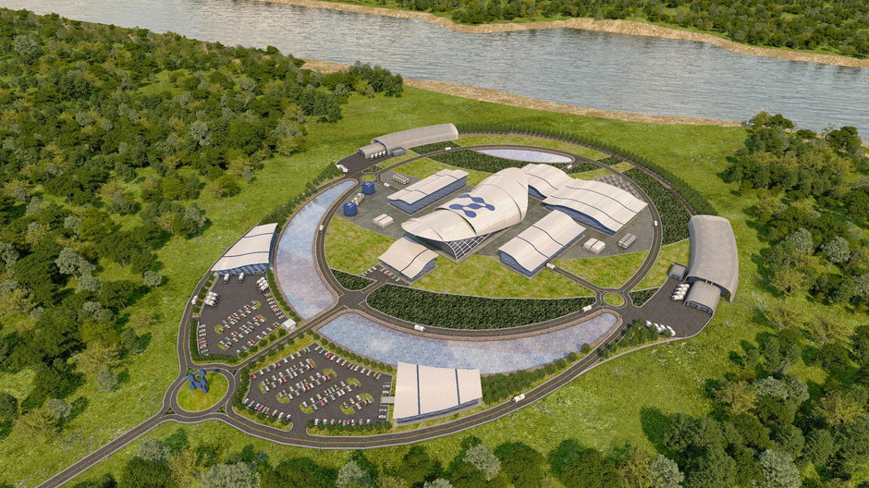
Continuum of Innovation
Advanced Fuels
Micro-Reactors
Advanced Non-LWRs
TerraPower
Oklo Aurora
2020
2025
2030
2035
Large Light Water
Small Modular Reactor
Watts Bar 2
Gas cooled
Liquid metal
Molten salt
Vogtle 3 & 4
NuScale

Slide 10
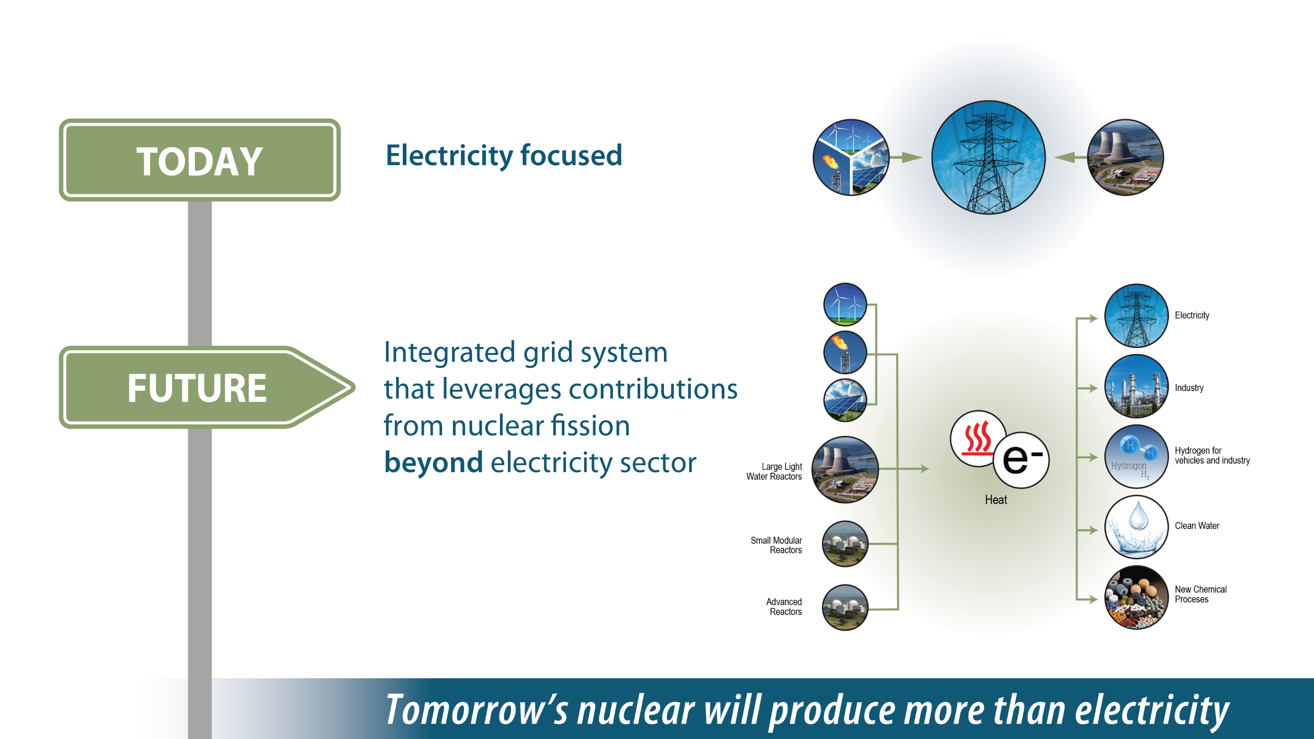
Moving beyond electricity

Slide 11
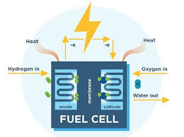
Hydrogen generation using existing reactor fleet
Exelon, First Energy, Xcel Energy, and Arizona Public Service have received DOE awards
Will demonstrate hydrogen production from large light water reactors starting in 2020 and 2021
Hydrogen could be used transportation, industrial processes, storage medium for electricity production
Notes:
Lenka

Slide 12
Key Takeaways
Consumers and policymakers (U.S. and abroad) increasingly demanding low-carbon electricity
States and utilities responding with deep decarbonization goals
Existing nuclear is the least expensive way to avoid carbon emissions vs. deployment of new generation sources
New nuclear is extremely valuable to deep decarbonization
  Least-cost, most reliable low-carbon systems include nuclear energy
  State and federal policy actions needed to overcome FOAK cost barriers
  Nuclear can help decarbonize non-electric energy uses

Slide 13
Links to NEI Resources for Legislators
How to Talk to Your Constituents About Nuclear Energy
Nuclear by the Numbers
Energy Market Rules Explained
Virtual Tour of Small Modular Reactor Facilities (Nuscale)
Video: Carbon-Free Energy Explainer
Nuclear State Fact Sheets
Report: Nuclear Energy in a Low Carbon Future

Slide 14
Contact Information
ELLEN C. GINSBERG | SR. VICE PRESIDENT, GENERAL COUNSEL AND SECRETARY
1201 F Street NW, Suite 1100 | Washington, DC 20004
P: 202.739.8140 | M: 202.437.0660
ecg@nei.org
CHRISTINE CSIZMADIA | DIRECTOR, STATE GOVERNMENT AFFAIRS & ADVOCACY
1201 F Street, NW, Suite 1100 | Washington, DC 20004
P: 202.739.8033 M: 202.352.3489
cmc@nei.org

