Slide 1


Emily Sanford Fisher
NFWL – Clean Energy Update
January 12, 2021

Slide 2
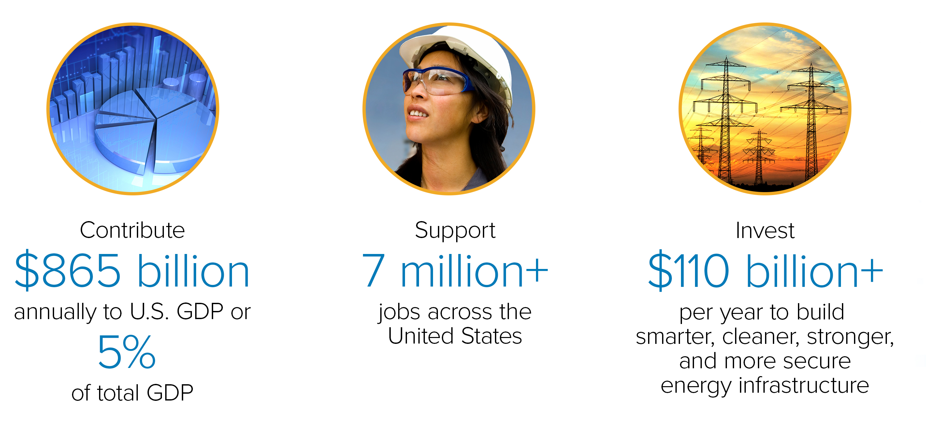
Creating Value in
America’s Economy

Slide 3
Leading On Clean Energy
Cutting Emissions
Notes:
At the same time, EEI’s member companies have aggressively increased their deployment and use of renewables. The amount of energy generated from non-hydro renewable sources has quadrupled since 2005.
Over the past eight years, more than half of new electricity generation capacity was wind and solar. As a result, our industry is responsible for virtually all the wind and geothermal in the country—and the majority of installed solar and hydropower capacity, too.
Today, nearly 40 percent of all U.S. power generation comes from carbon-free sources, including nuclear energy and hydropower and other renewables.

Slide 4
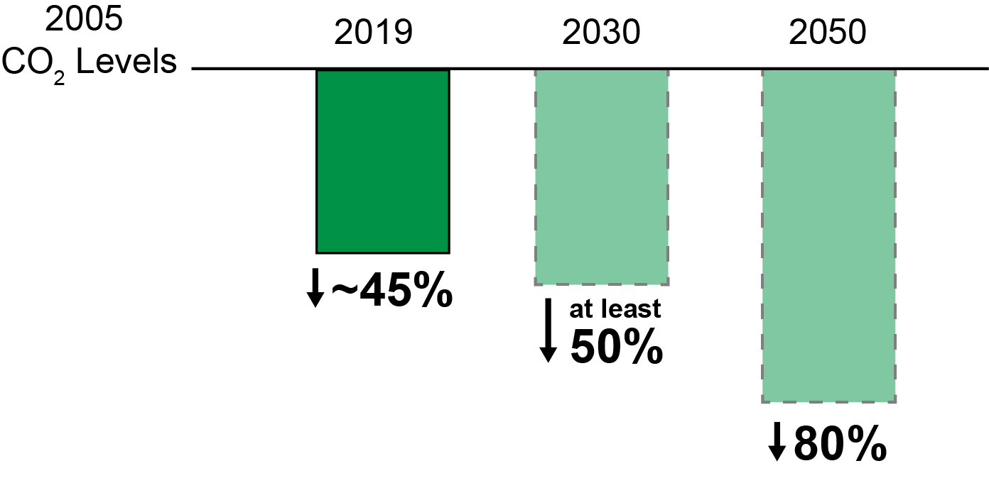
Our Commitment:
As Clean As We Can, As Fast As We Can
EEI Member Company
CO₂ Reductions & Goals
While Keeping Customer Reliability And Affordability Front And Center As Always
Notes:
And, we are poised—and committed—to achieve even more. Collectively, EEI’s member companies are on a path to reduce carbon emissions 50 percent by 2030, and 80 percent by 2050, compared with 2005 levels.
On the clean energy journey, many pathways can lead to the same collective result. Importantly, EEI’s member companies are implementing customized strategies that align with their individual circumstances to reduce carbon emissions without compromising on the reliability, affordability, or security that are essential to the customers they serve.

Slide 5
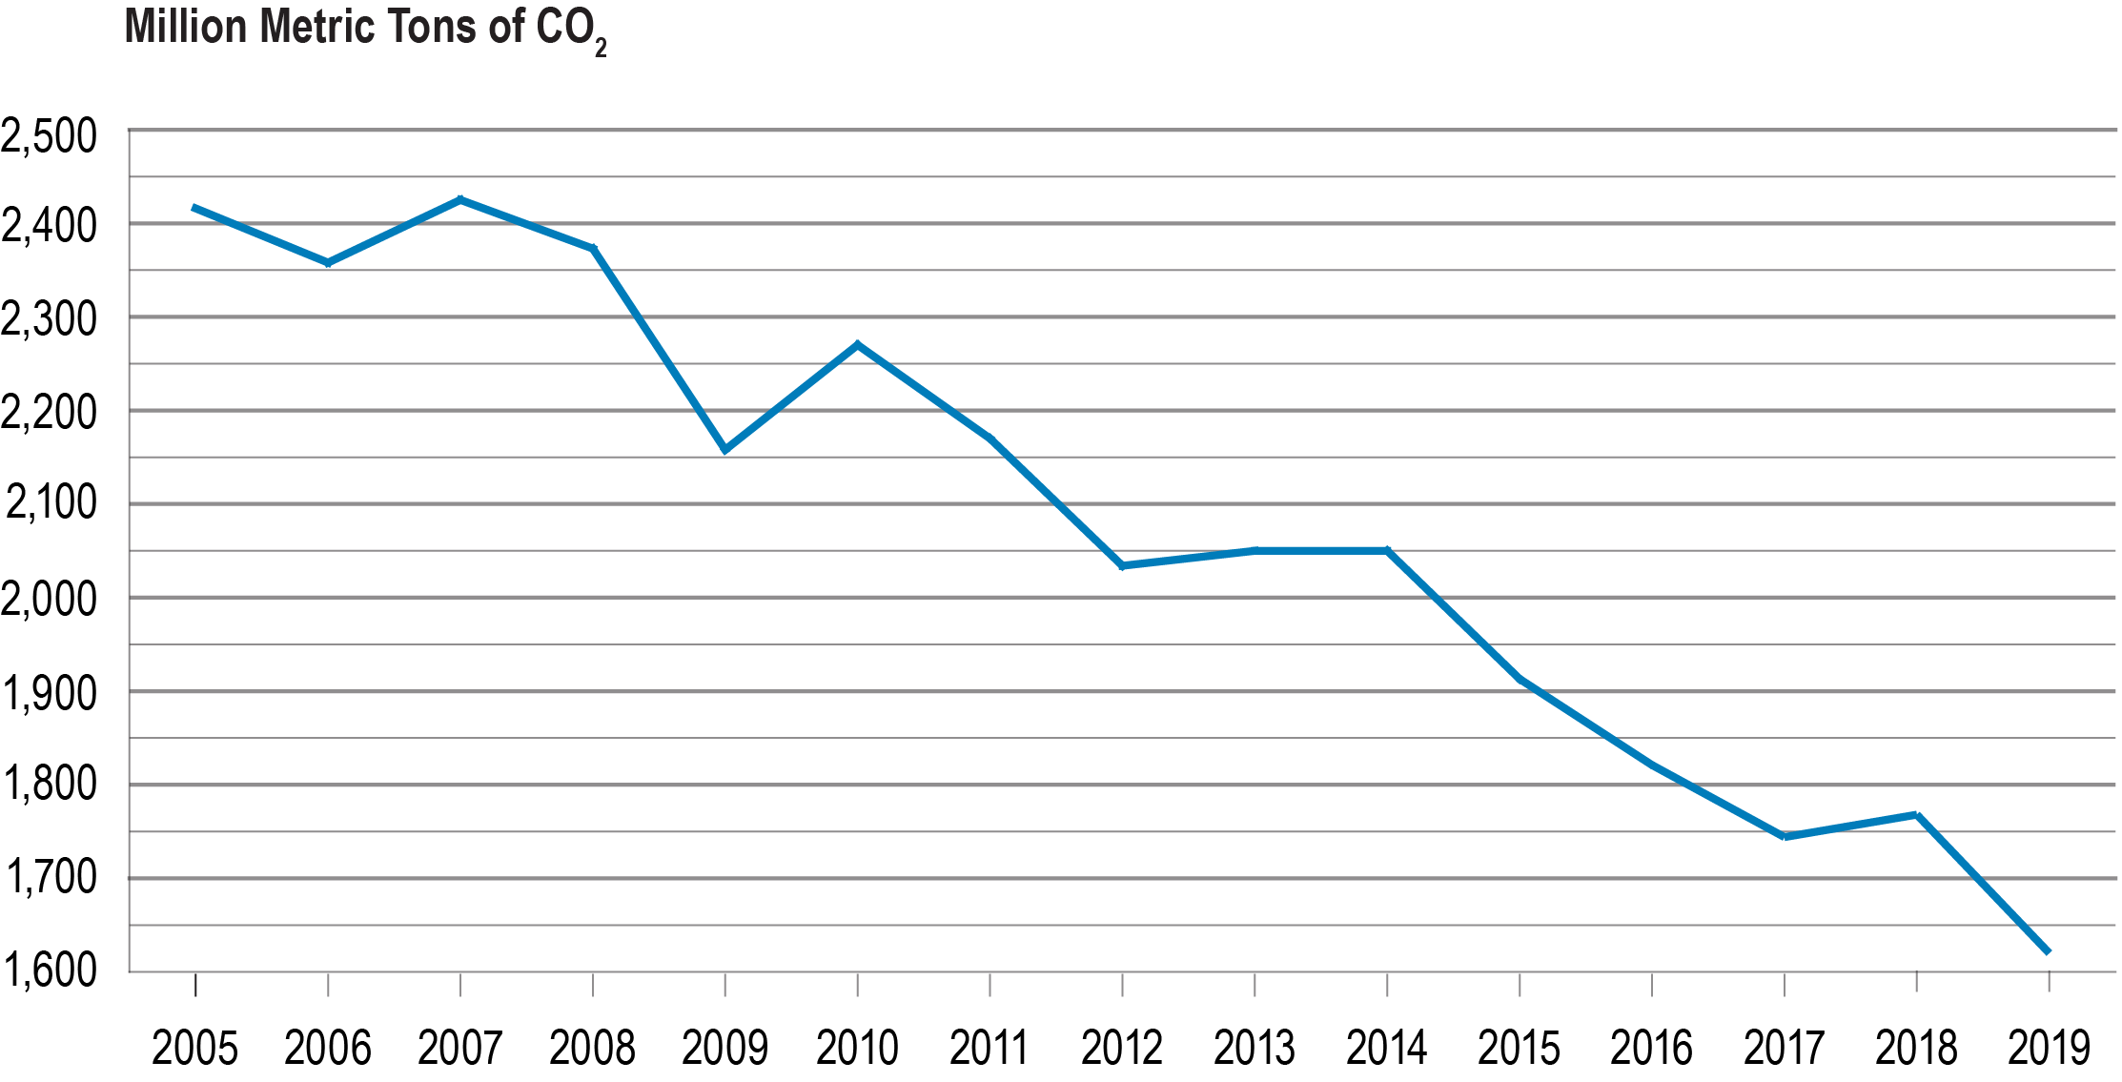
Reducing Carbon Emissions
Nearly 40 percent
of U.S. electricity comes from carbon-free sources
As of 2019, electric power industry CO₂ emissions are 33 percent below 2005 levels
Trajectory is expected to continue based on current trends
Source: U.S. Department of Energy, Energy Information Administration, Monthly Energy Review, March 2020.

Slide 6
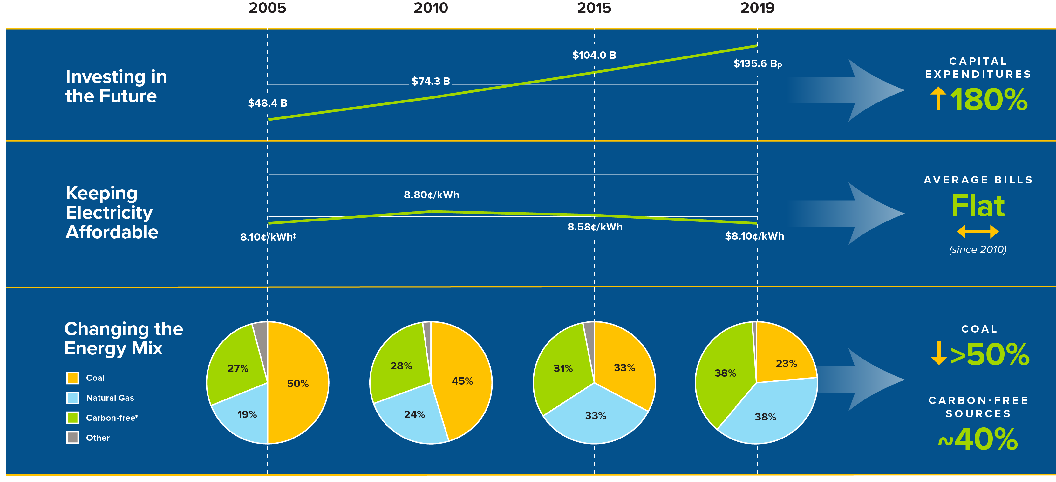
Our Clean Energy Journey
From 2005 Levels
33%
Electric Power Industry
Carbon Emissions**
Sources and Notes: ‡Average Annual U.S. Retail Electricity Rates 2005–2019 (real 2005 $) | *Carbon-free = nuclear and hydropower and other renewables | **U.S. Department of Energy, Energy Information Administration, Monthly Energy Review, March 2020
Notes:
From every perspective, our sector’s carbon emissions are at nearly the lowest level in three decades.
As of year-end 2018, EEI’s member companies had reduced their carbon dioxide (CO₂) emissions approximately 37 percent below peak 2005 levels, outpacing the entire power sector’s impressive overall 27 percent reduction during that time.
And, early 2019 numbers indicate that this trend is continuing: overall, the sector’s CO₂ emissions have fallen a projected 30 percent from 2005. EEI member-specific data is not available yet, but we expect the trend of our members’ emissions reductions exceeding overall sector reductions to continue.
Our progress is the result of significant changes across the generation fleet. Roughly two-thirds of the emissions reductions achieved to date are the result of switching from coal to natural gas; since 2005, coal use has been cut by more than half. This shift has allowed EEI member companies to take advantage of the cost advantages and 24/7/365 reliability and dispatchability of natural gas to achieve deeper and faster emission reductions.

Slide 7
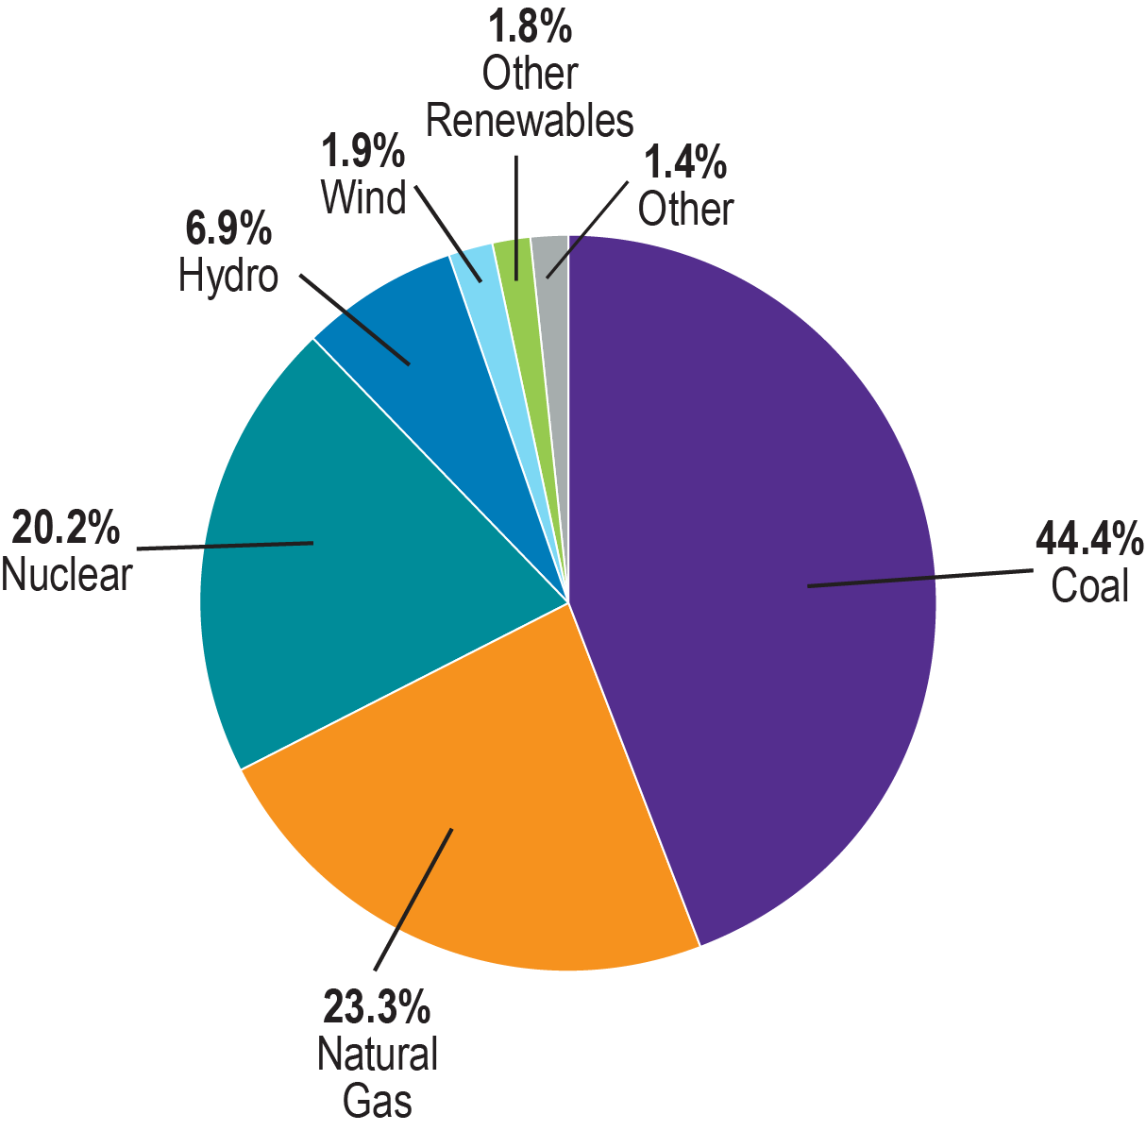
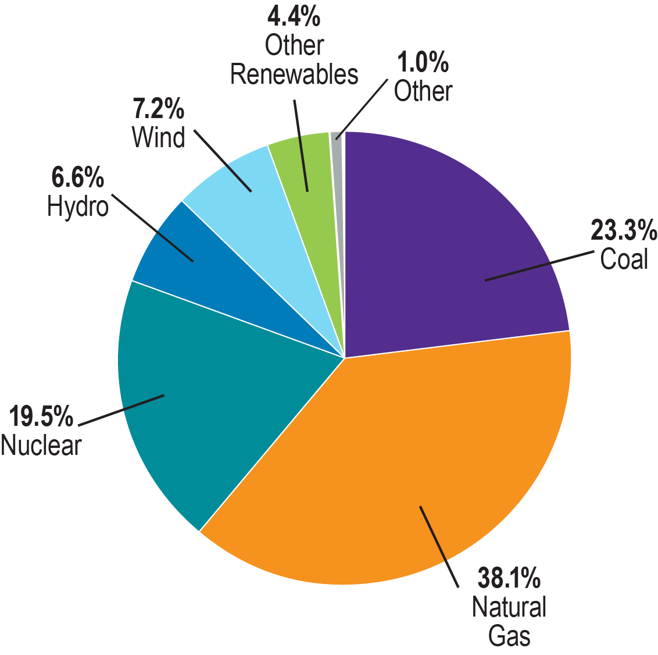
Transforming the Energy Mix
2009 National Energy
Resource Mix
2019 National Energy
Resource Mix
Source: U.S. Department of Energy, Energy Information Administration.

Slide 8
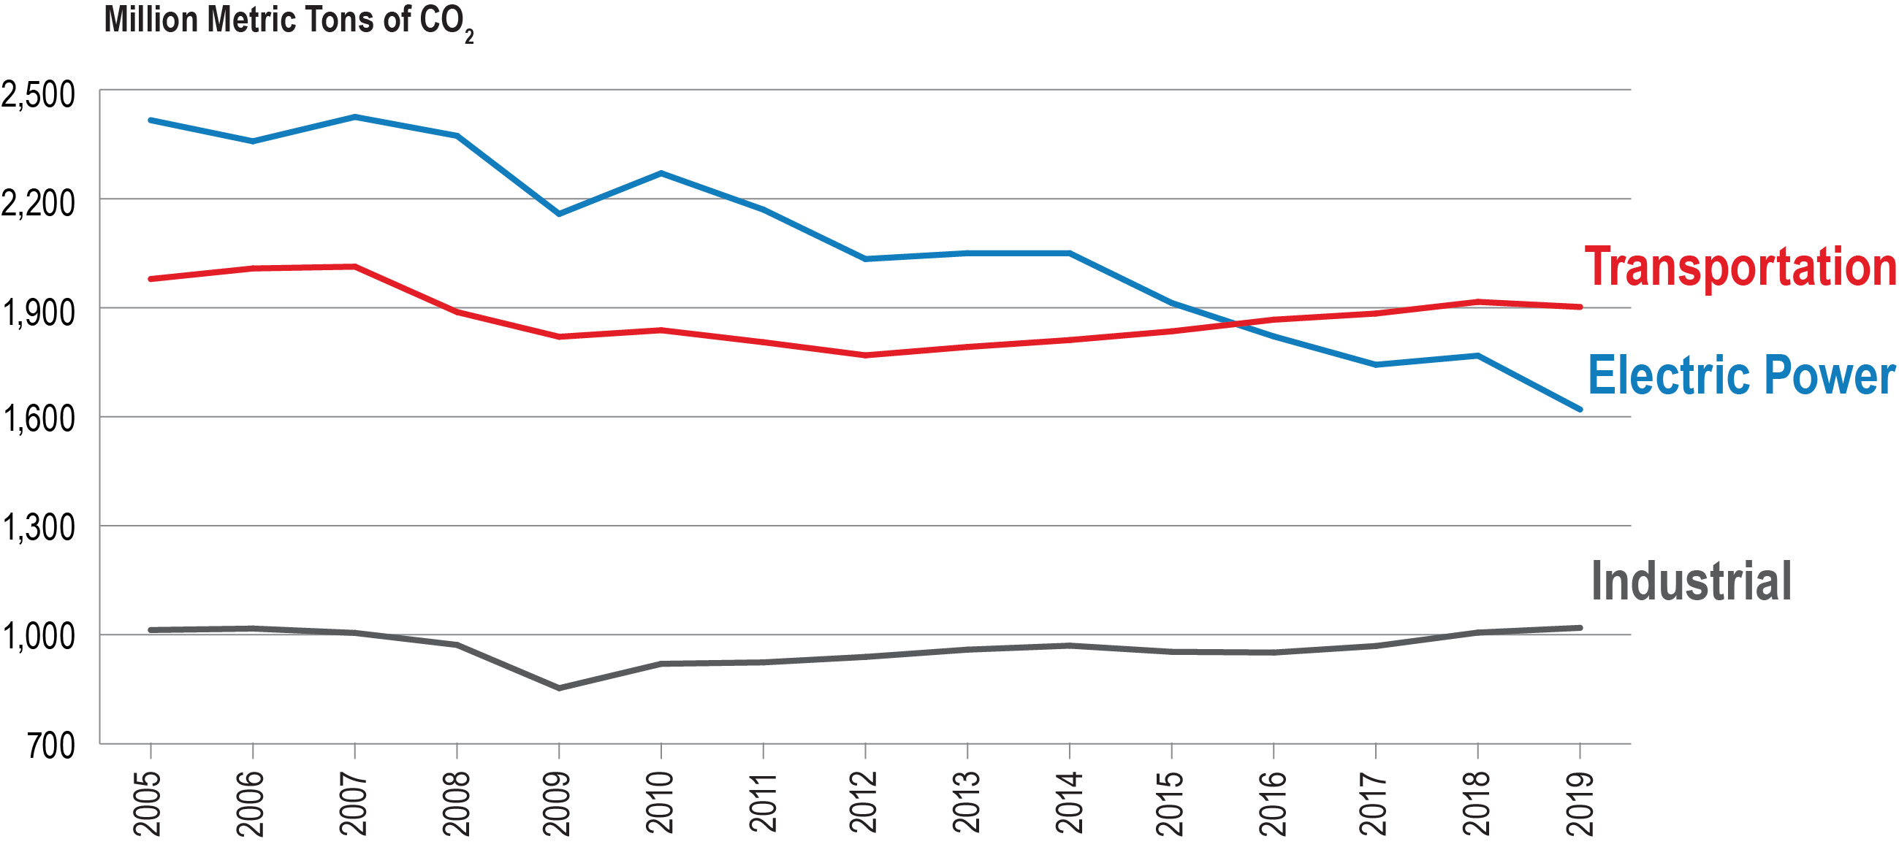
Comparing CO₂ Emissions:
Electric Power, Transportation, and Industrial Sectors
Source: U.S. Department of Energy, Energy Information Administration, Monthly Energy Review, March 2020.

Slide 10
Emily Fisher
Edison Electric Institute
efisher@eei.org
202-731-5887

Slide 11
How a Diverse Energy Portfolio Can Achieve Clean Energy Goals
Ellen Ginsberg
Sr Vice President, General Counsel and Secretary
January 12, 2021

Slide 12
Nuclear generates nearly 20% of U.S. electricity
Biomass & Petroleum – 1.9%
Solar – 1.8%
Geothermal – 0.4%
Hydro
6.8%
Nuclear
19.7%
Wind
7.3%
Coal
23.5%
Natural Gas
38.4%
KEY
Nuclear power plant site
Source: U.S. Energy Information Administration
Updated: February 2020

Slide 13
Growth from efficiency improvements and uprates are equivalent to 32 new 1,000 megawatt power plants
Electricity
Generated
(Million MWh)
Equivalent to 32 new power plants
Source: Emissions avoided are calculated using regional and national fossil fuel emissions rates from the U.S. Environmental Protection Agency and plant generation data from the U.S. Energy Information Administration.
Updated: March 2020

Slide 14
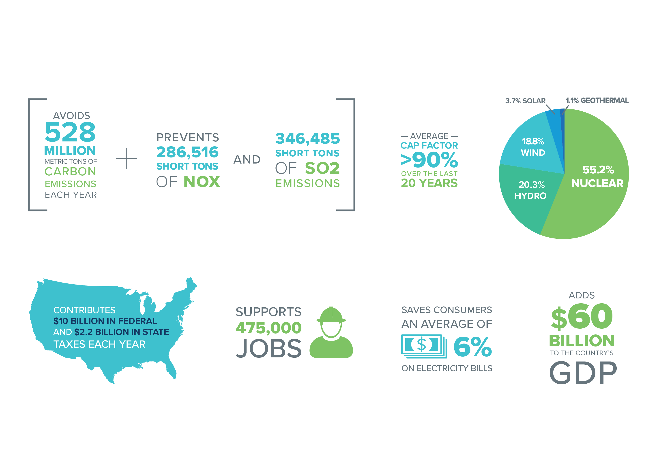
Nuclear Contributions

Slide 15
Nuclear supplied more than half of U.S. carbon-free electricity in 2019
Solar – 4.9%
Geothermal – 1.1%
Carbon-free resources generated about 37% of U.S. electricity in 2019
Carbon-free generation in U.S. increased by net 18.7 million MWh in 2019
Hydro
18.9%
Nuclear
54.8%
Wind
20.3%
Source: U.S. Energy Information Administration
Updated: February 2020

Slide 16
Emissions avoided by the nuclear industry in 2019 are equivalent to emissions from nearly 110 million cars
CO₂ Emissions (Million Metric Tons)
Source: Emissions avoided are calculated using regional and national fossil fuel emissions rates from the U.S. Environmental Protection Agency and plant generation data from the U.S. Energy Information Administration.
Updated: July 2020

Slide 17
Utility carbon emission projections based on pledges
Source: ABB Velocity Suite, U.S. Environmental Protection Agency, utility news releases.

Slide 18
Recognizing the Carbon-Free Attribute
Utility plans
Duke Energy
SLR planned for all 11 reactors
SMRs, Advanced Reactors an option in IRP
Dominion Energy
SLR applications under review for all 4 reactors
SMRs, Advanced Reactors an option in IRP
Multiple generating companies reportedly teaming with developers for Advanced Reactor Demonstration Program awards
UTILITY DECARB PLANS INCLUDE SLR, ROLE FOR NEW NUCLEAR

Slide 19

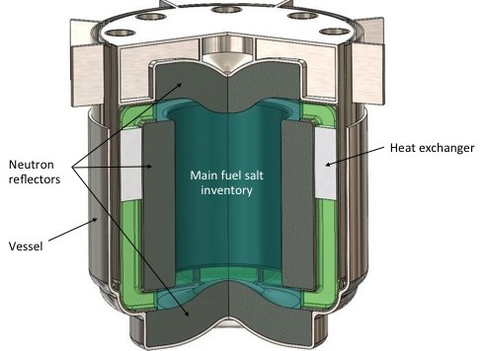

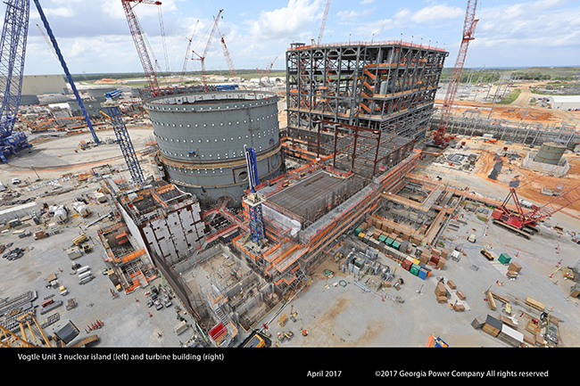
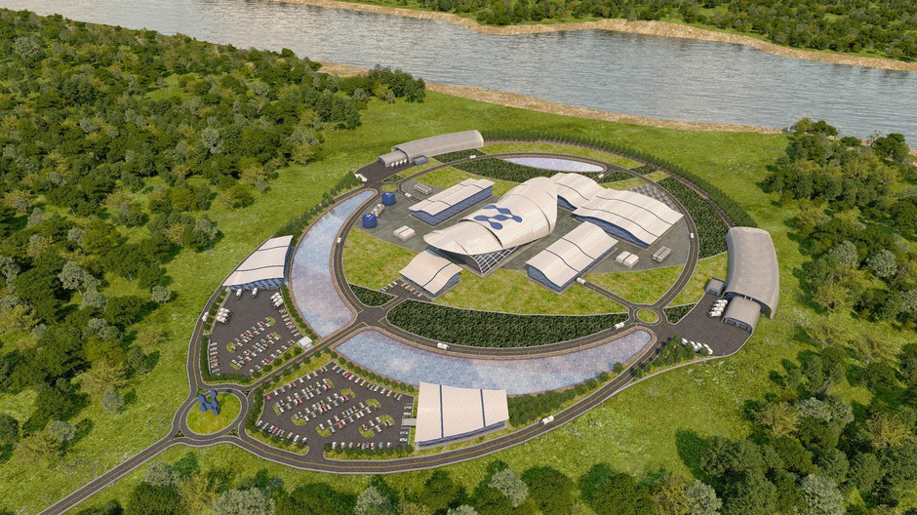
Continuum of Innovation
Advanced Fuels
Micro-Reactors
Advanced Non-LWRs
TerraPower
Oklo Aurora
2020
2025
2030
2035
Large Light Water
Small Modular Reactor
Watts Bar 2
Gas cooled
Liquid metal
Molten salt
Vogtle 3 & 4
NuScale

Slide 20
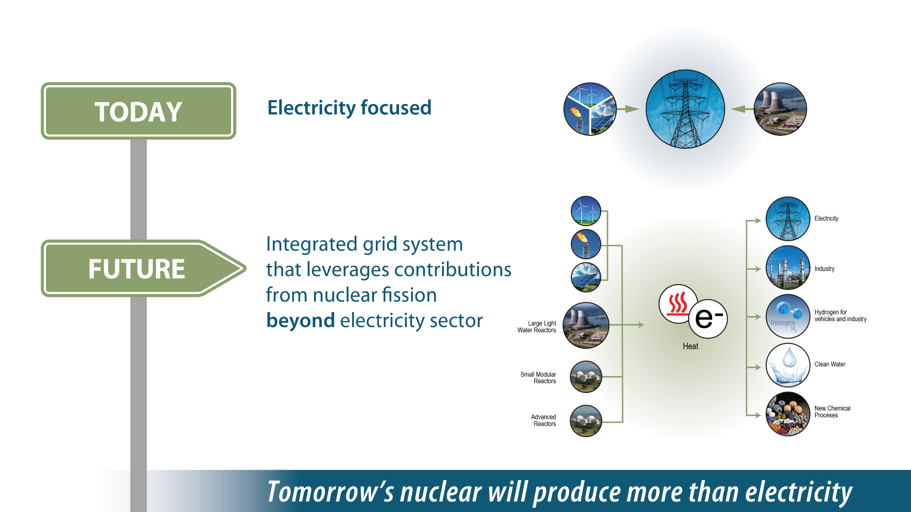
Moving beyond electricity

Slide 21
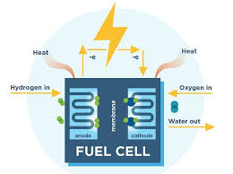
Hydrogen generation using existing reactor fleet
Exelon, First Energy, Xcel Energy, and Arizona Public Service have received DOE awards
Will demonstrate hydrogen production from large light water reactors starting in 2020 and 2021
Hydrogen could be used transportation, industrial processes, storage medium for electricity production
Notes:
Lenka

Slide 22
Key Takeaways
Consumers and policymakers (U.S. and abroad) increasingly demanding low-carbon electricity
States and utilities responding with deep decarbonization goals
Existing nuclear is the least expensive way to avoid carbon emissions vs. deployment of new generation sources
New nuclear is extremely valuable to deep decarbonization
  Least-cost, most reliable low-carbon systems include nuclear energy
  State and federal policy actions needed to overcome FOAK cost barriers
  Nuclear can help decarbonize non-electric energy uses

Slide 23
Links to NEI Resources for Legislators
How to Talk to Your Constituents About Nuclear Energy
Nuclear by the Numbers
Energy Market Rules Explained
Virtual Tour of Small Modular Reactor Facilities (Nuscale)
Video: Carbon-Free Energy Explainer
Nuclear State Fact Sheets
Report: Nuclear Energy in a Low Carbon Future

Slide 24
Contact Information
ELLEN C. GINSBERG | SR. VICE PRESIDENT, GENERAL COUNSEL AND SECRETARY
1201 F Street NW, Suite 1100 | Washington, DC 20004
P: 202.739.8140 | M: 202.437.0660
ecg@nei.org
CHRISTINE CSIZMADIA | DIRECTOR, STATE GOVERNMENT AFFAIRS & ADVOCACY
1201 F Street, NW, Suite 1100 | Washington, DC 20004
P: 202.739.8033 M: 202.352.3489
cmc@nei.org

