Slide 1


Emily Sanford Fisher
NFWL – Clean Energy Update
January 12, 2021

Slide 2
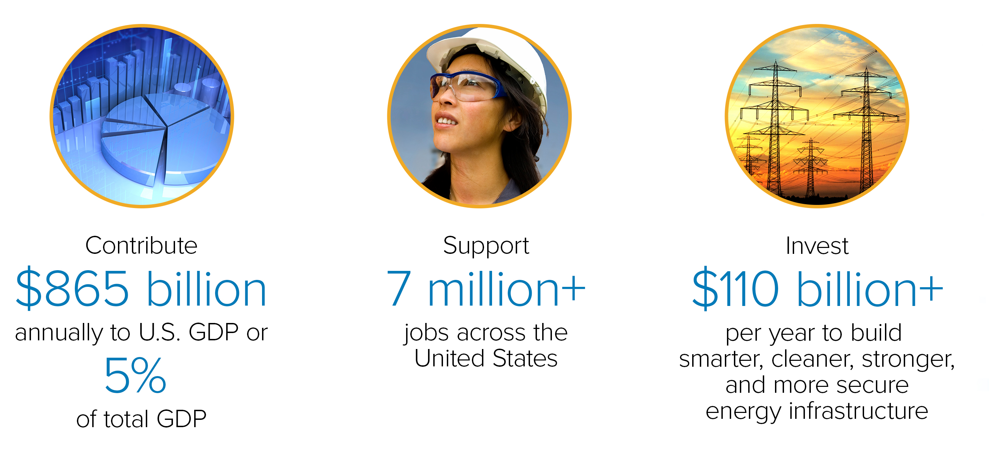
Creating Value in
America’s Economy

Slide 3
Leading On Clean Energy
Cutting Emissions
Notes:
At the same time, EEI’s member companies have aggressively increased their deployment and use of renewables. The amount of energy generated from non-hydro renewable sources has quadrupled since 2005.
Over the past eight years, more than half of new electricity generation capacity was wind and solar. As a result, our industry is responsible for virtually all the wind and geothermal in the country—and the majority of installed solar and hydropower capacity, too.
Today, nearly 40 percent of all U.S. power generation comes from carbon-free sources, including nuclear energy and hydropower and other renewables.

Slide 4
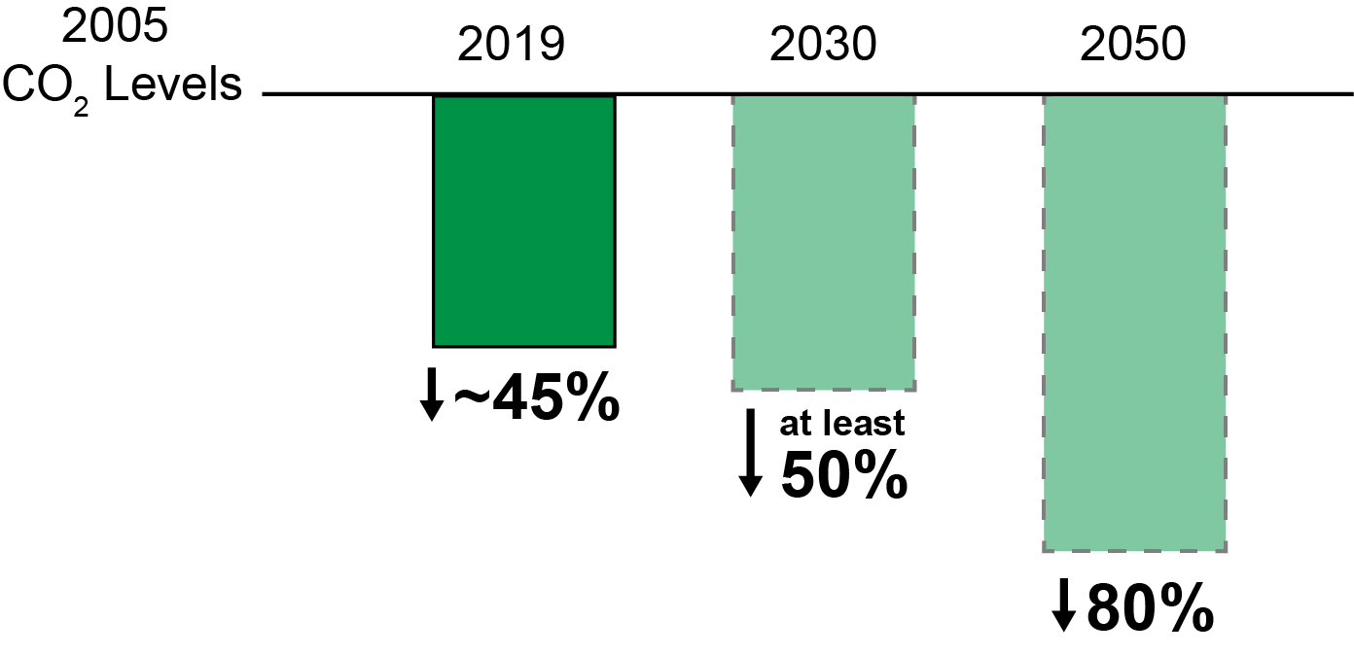
Our Commitment:
As Clean As We Can, As Fast As We Can
EEI Member Company
CO₂ Reductions & Goals
While Keeping Customer Reliability And Affordability Front And Center As Always
Notes:
And, we are poised—and committed—to achieve even more. Collectively, EEI’s member companies are on a path to reduce carbon emissions 50 percent by 2030, and 80 percent by 2050, compared with 2005 levels.
On the clean energy journey, many pathways can lead to the same collective result. Importantly, EEI’s member companies are implementing customized strategies that align with their individual circumstances to reduce carbon emissions without compromising on the reliability, affordability, or security that are essential to the customers they serve.

Slide 5
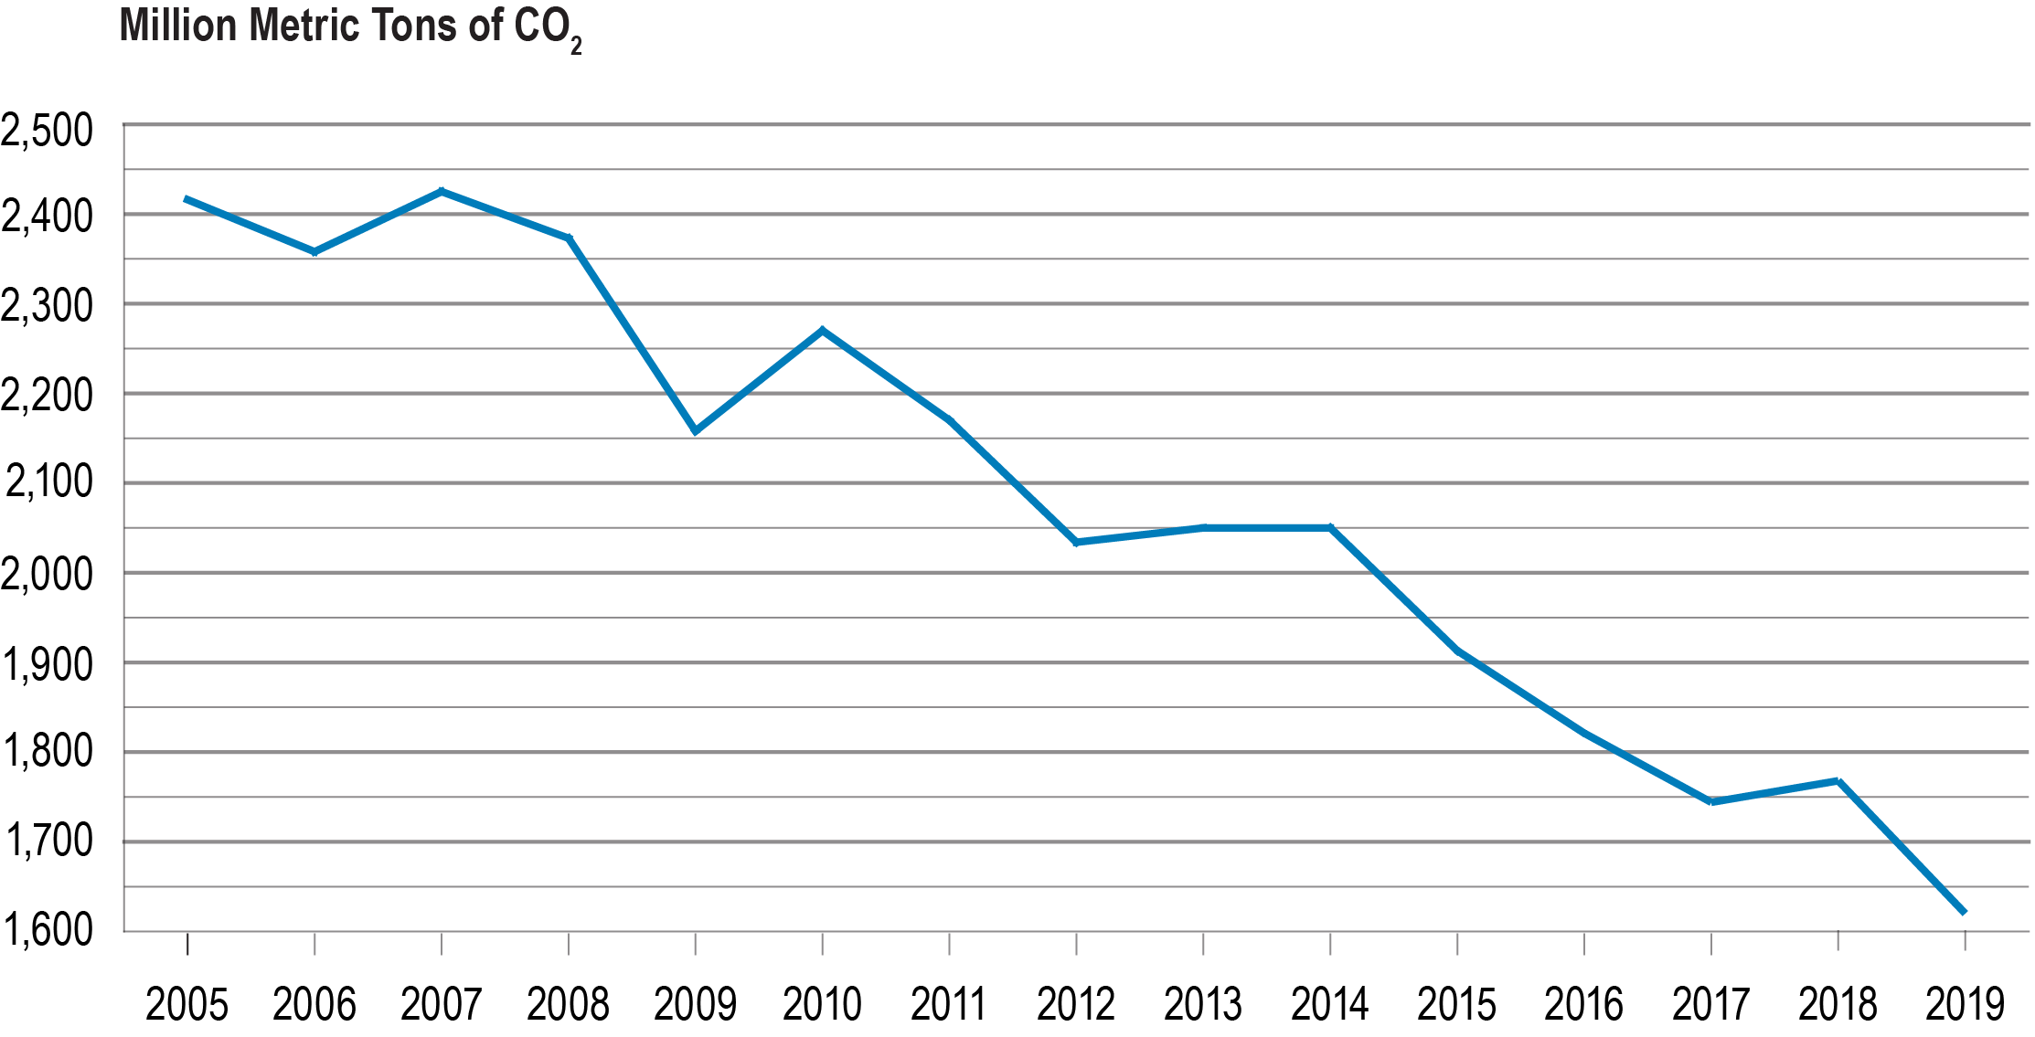
Reducing Carbon Emissions
Nearly 40 percent
of U.S. electricity comes from carbon-free sources
As of 2019, electric power industry CO₂ emissions are 33 percent below 2005 levels
Trajectory is expected to continue based on current trends
Source: U.S. Department of Energy, Energy Information Administration, Monthly Energy Review, March 2020.

Slide 6
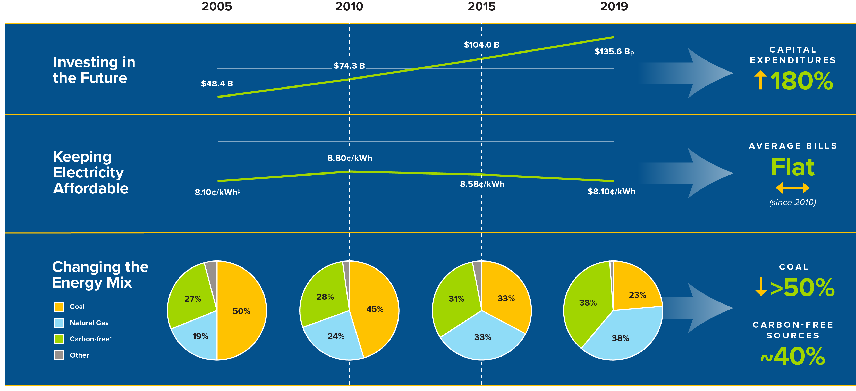
Our Clean Energy Journey
From 2005 Levels
33%
Electric Power Industry
Carbon Emissions**
Sources and Notes: ‡Average Annual U.S. Retail Electricity Rates 2005–2019 (real 2005 $) | *Carbon-free = nuclear and hydropower and other renewables | **U.S. Department of Energy, Energy Information Administration, Monthly Energy Review, March 2020
Notes:
From every perspective, our sector’s carbon emissions are at nearly the lowest level in three decades.
As of year-end 2018, EEI’s member companies had reduced their carbon dioxide (CO₂) emissions approximately 37 percent below peak 2005 levels, outpacing the entire power sector’s impressive overall 27 percent reduction during that time.
And, early 2019 numbers indicate that this trend is continuing: overall, the sector’s CO₂ emissions have fallen a projected 30 percent from 2005. EEI member-specific data is not available yet, but we expect the trend of our members’ emissions reductions exceeding overall sector reductions to continue.
Our progress is the result of significant changes across the generation fleet. Roughly two-thirds of the emissions reductions achieved to date are the result of switching from coal to natural gas; since 2005, coal use has been cut by more than half. This shift has allowed EEI member companies to take advantage of the cost advantages and 24/7/365 reliability and dispatchability of natural gas to achieve deeper and faster emission reductions.

Slide 7
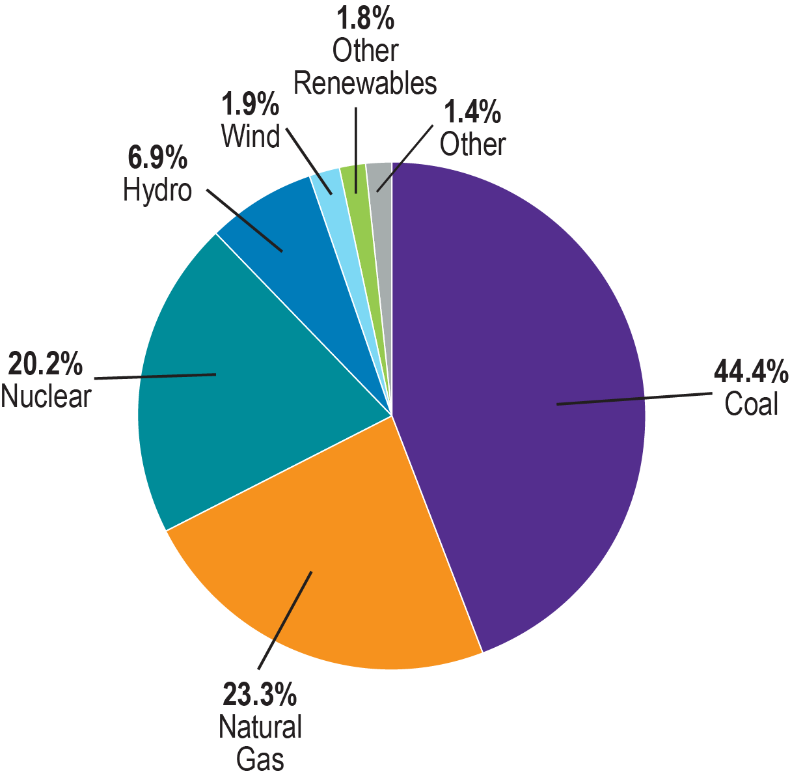
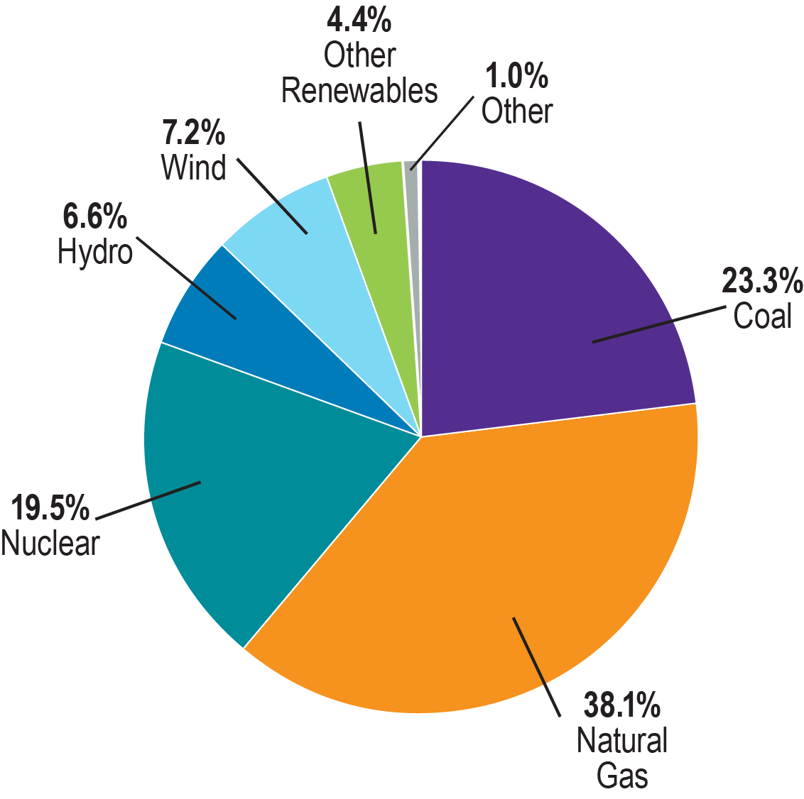
Transforming the Energy Mix
2009 National Energy
Resource Mix
2019 National Energy
Resource Mix
Source: U.S. Department of Energy, Energy Information Administration.

Slide 8
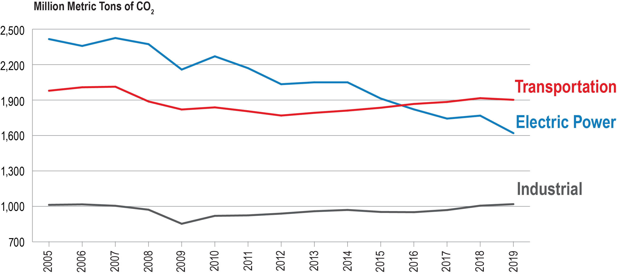
Comparing CO₂ Emissions:
Electric Power, Transportation, and Industrial Sectors
Source: U.S. Department of Energy, Energy Information Administration, Monthly Energy Review, March 2020.

Slide 10
Emily Fisher
Edison Electric Institute
efisher@eei.org
202-731-5887

